Slide 1
Netflix MoVIES AND TV SHOWS aNALYSiS
PROJECT MENTOR
BHOOMIKA MALLIREDDY

Slide 2
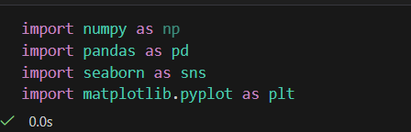
GATHERING DATASETS AND LIBRARIES
Downloading Dataset from Kaggle - Netflix Movies and TV shows Dataset
Import Required libraries : Numpy, Pandas, Matplotlib, Seaborn
Importing Required Libraries

Slide 3
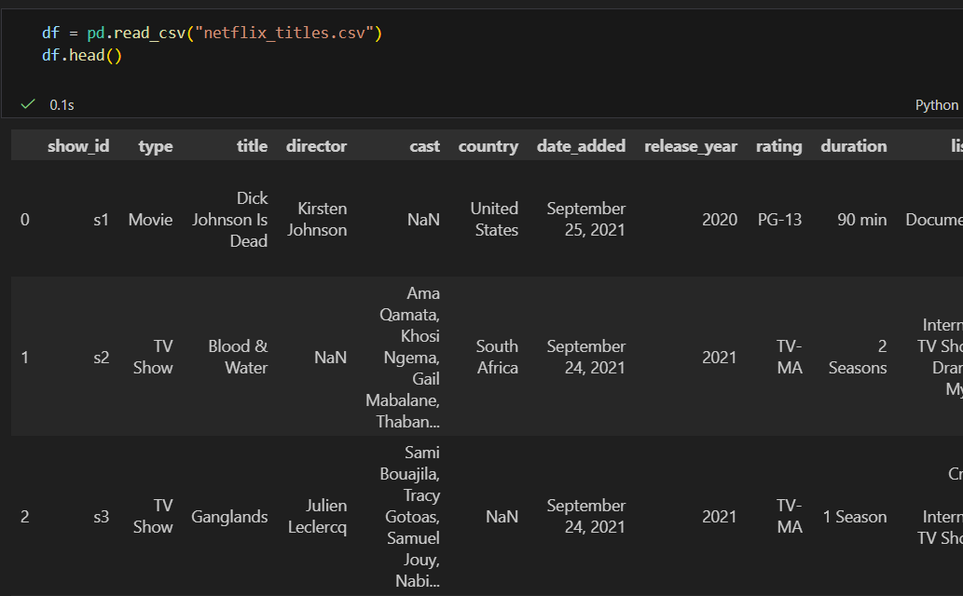
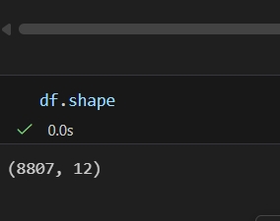
Loading Dataset
read_csv() is a Pandas function used to read data from a CSV (Comma-Separated Values) file and convert it into a DataFrame, which is a structured table of rows and columns.
1.Loads the dataset from the system.
2.Display the dataset in tabular format.
It has 8807 rows and 12 Columns

Slide 4
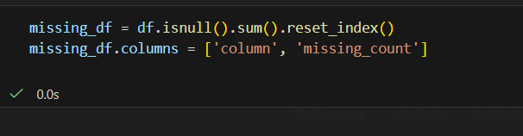
Creating Missing Value Summary
This step transformed raw null information into a format suitable for visualization.
df.isnull().sum() calculates total missing values per column.
reset_index() converts the result into a structured dataframe.
Columns were renamed for clarity.
This step transformed raw null information into a format suitable for visualization.

Slide 5
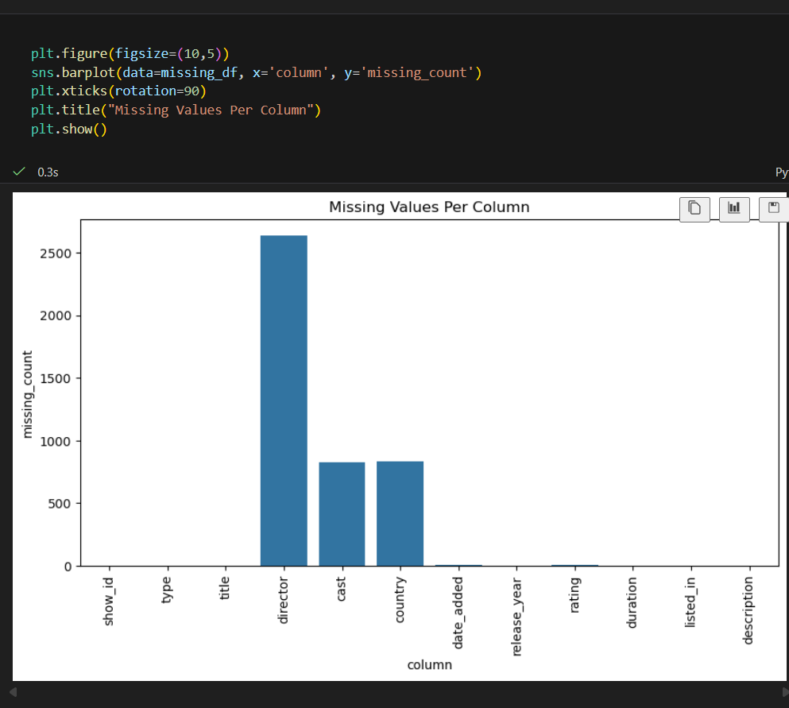
Visualizing Missing Values
A bar chart was used to compare missing
values across columns.
X-axis shows column names.
Y-axis shows total missing values.
Rotation improves readability.
This visualization clearly highlights that:
director had the highest missing values.
cast and country also had significant gaps.
Other columns had minimal or no missing values.

Slide 6
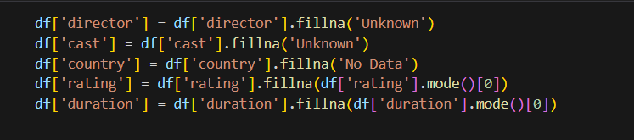
Handing of Missing Values
Categorical columns with high missing values were filled with ‘Unknown’ and ‘No Data’ to:
Preserve row information
Avoid deleting large amounts of data
Maintain categorical consistency
For columns with very few missing values:
Mode (most frequent value) was used.
This maintains realistic distribution.
Prevents introducing artificial bias.

Slide 7
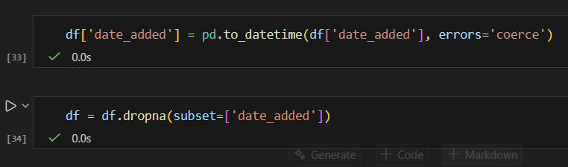
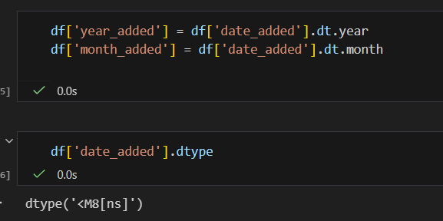
Handling Date Column
Converted date_added from object to datetime format.
errors='coerce' ensures invalid formats become NaT.
Rows with invalid or missing dates were removed.
This enables time-based analysis.
New features were extracted from the date column:
year_added helps analyze growth trends.
month_added enables seasonal analysis.

Slide 8
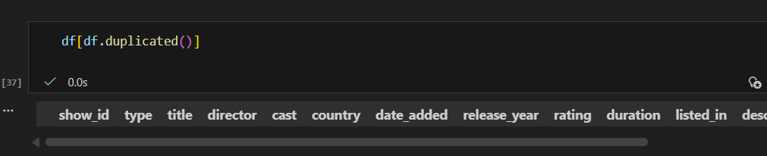
Checking for Duplicates
It is used for finding duplicates in Dataset
No Duplicates Found

Slide 9
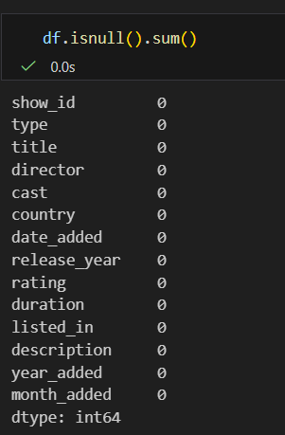
Final Validation
Final checks ensured:
No remaining critical missing values
Dataset structure is consistent

Slide 10
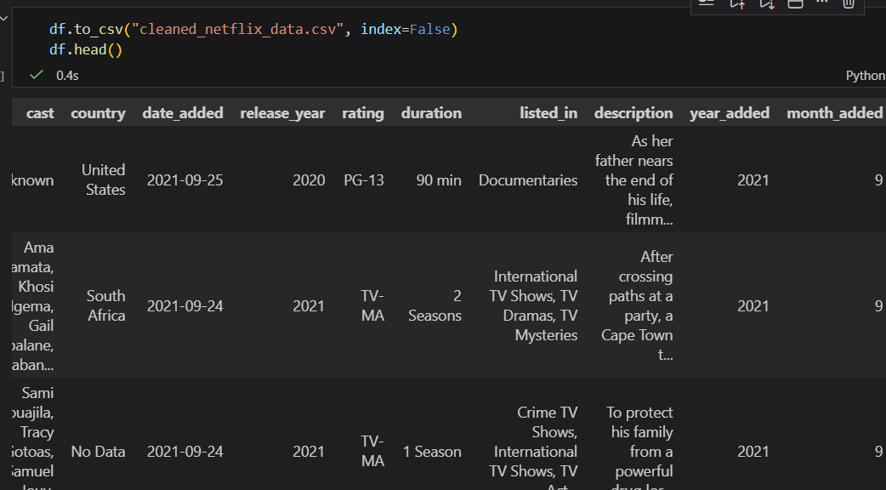
Output Dataset
The cleaned dataset was exported for use
It was names as “cleaned_netflix_data.csv”
It is flexible for further process like:
Modeling
Creating Dashboards etc

Slide 11
Thank you

